Slide 1
Assignment 10 supervised Learning Part 1
5420 Anomaly Detection, Fall 2020
- Harsh Dhanuka, hd2457

Slide 2

5420 Anomaly Detection, Fall 2020
- Harsh Dhanuka, hd2457
Agenda
LOAN DEFAULT
Loan default occurs when a borrower fails to pay back a debt according to the initial arrangement.
Predict which loan holders will likely default
0 = No Default 1 = Default
Which techniques to use?
Which H2O packages to use?
How to convey the results?
Around $20 billion defaults only in student loans in US

Slide 3
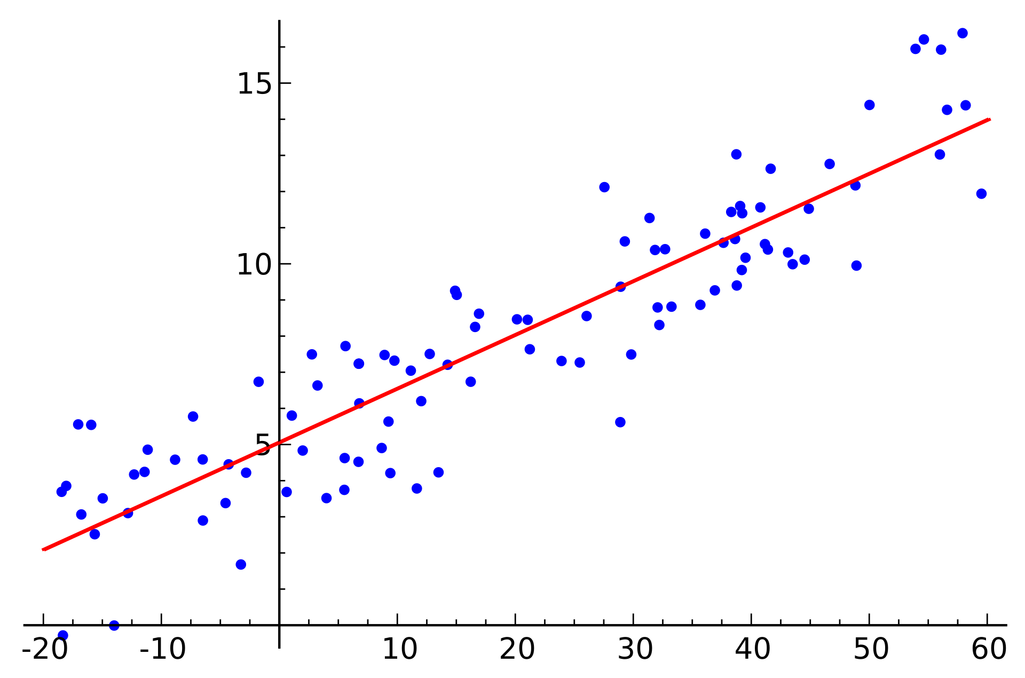
GLM Model
The generalized linear model (GLM) is a flexible generalization of ordinary linear regression that allows for response variables that have error distribution models other than a normal distribution. The GLM generalizes linear regression by allowing the linear model to be related to the response variable via a link function and by allowing the magnitude of the variance of each measurement to be a function of its predicted value. The GLM suite includes: Gaussian regression, Poisson regression, Binomial regression (classification), Fractional binomial
regression, Quasibinomial regression, Multinomial classification, Gamma regression, Ordinal regression, Negative Binomial regression, Tweedie distribution
H2O
H2O is a fully open source, distributed in-memory machine learning platform with linear scalability. H2O supports the most widely used statistical & machine learning algorithms including gradient boosted machines, generalized linear models, deep learning and more. H2O also has an industry leading AutoML functionality that automatically runs through all the algorithms and their hyperparameters to produce a leaderboard of the best models.

Slide 4
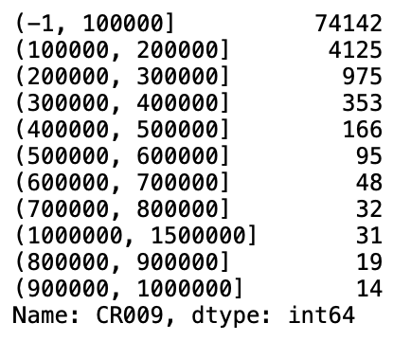
5420 Anomaly Detection, Fall 2020
- Harsh Dhanuka, hd2457
Considerations
1. Feature Engineering
Convert Date/Time columns
Education Code, Gender, City converted to categorical type
Drop empty value variables and constants
Bin the Loan Amount column
2. Missing values
Convert mis-represented NA’s such as -99, to np.nan
Use Iterative Imputer to fill with median
3. Dummy coding of Categorical variables not needed
4. Split to train_test
- I used 75% data in train set. Convert all dataframes to H2O hex format.
Loan Amount Bin ($) Count

Slide 5
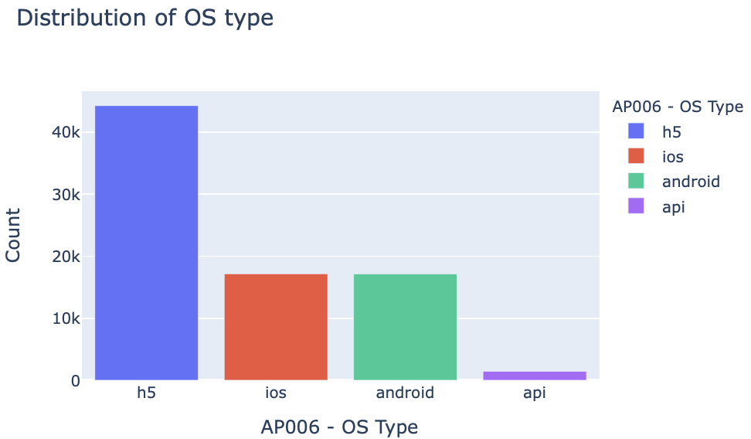
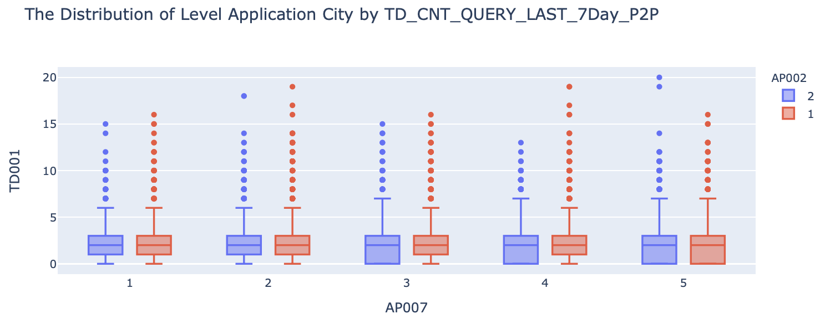
5420 Anomaly Detection, Fall 2020
- Harsh Dhanuka, hd2457
Exploratory Data Analysis
1
Distribution of AP006 – OS Type
2
Distribution of Application City (AP007) by the Count of Query in 7 days
Colored by Gender (AP002)

Slide 6
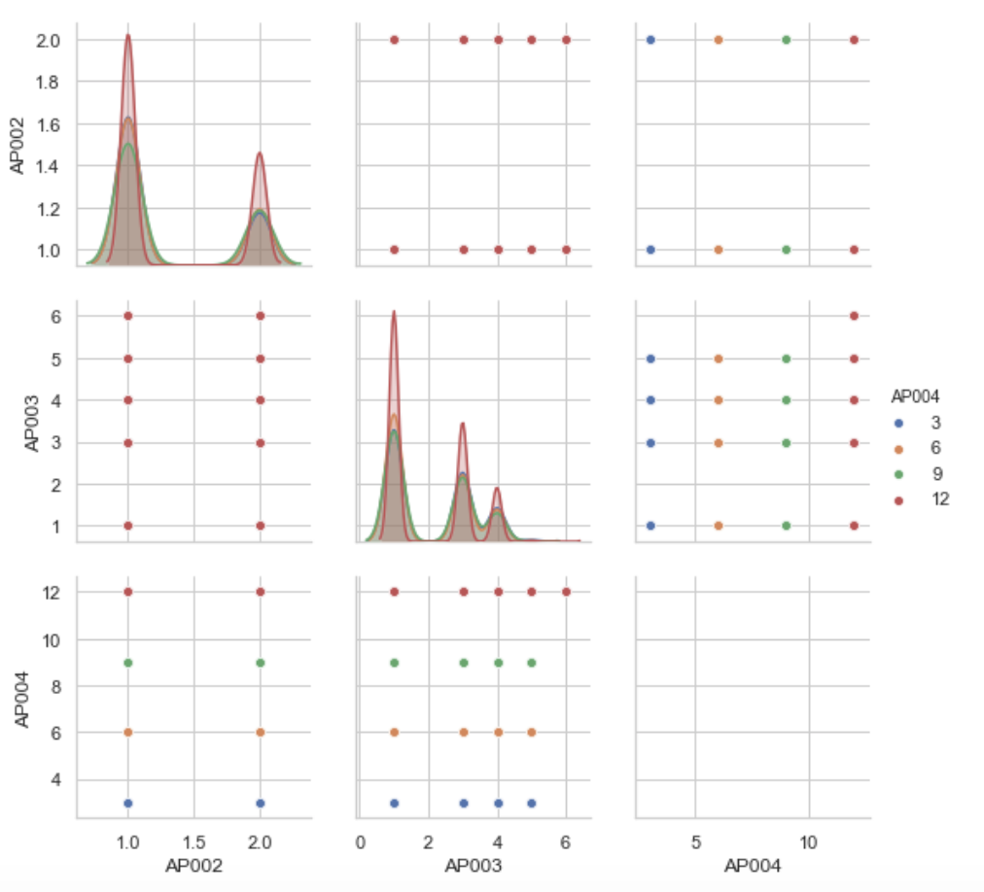
5420 Anomaly Detection, Fall 2020
- Harsh Dhanuka, hd2457
Exploratory Data Analysis
Checking relations between:
AP002 – Gender
AP003 – Education Code
AP004 – Loan Term
3

Slide 7
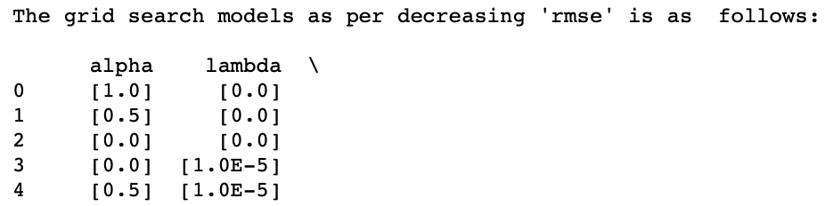
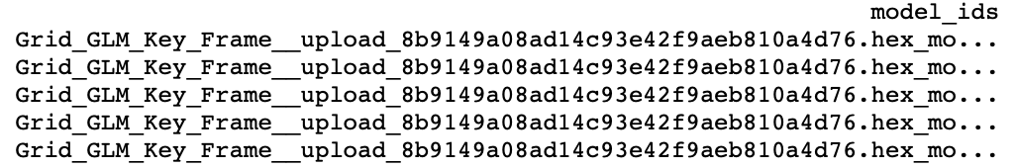
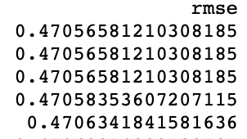
5420 Anomaly Detection, Fall 2020
- Harsh Dhanuka, hd2457
GLM Model
2
Use H2O GLM Grid Search to find optimal parameters - Cartesian
https://docs.h2o.ai/h2o/latest-stable/h2o-docs/grid-search.html
1
Run a Basic Model with default parameters
This gives an overall idea of the computational time, and potential output.
lambda: [1, 0.5, 0.03, 0.02, 0.1, 0.01, 0.05, 0.08, 0.001, 0.003, 0.005, 0.0001, 0.0005, 0.00001, 0]
alpha: [1, 0.5, 0]
family: ‘fractionalbinomial’
Grid Search takes around 1 minute to run
Best Model is judged by checking R² and rmse scores

Slide 8
5420 Anomaly Detection, Fall 2020
- Harsh Dhanuka, hd2457
GLM Model
3
Run and Train GLM with Regularization Model with optimal parameters
4
Check variable importance and re-run
Out of the total 75 variables, I pick a combination of different number of variables such as top 20, top 30, top 40 and 50 variables to re-run the model.
But, the best Lift score is given when I use all the 75 variables.
After identifying the best parameters, I will run the final GLM with Regularization model and train it using the train set, and validate it on the test set.
Final Parameters:
family = "AUTO"
lambda_ = 0
lambda_search = True
alpha = 1
nfolds = 10,
stopping_rounds = 0
standardize = True
balanced_classes parameter did not make any difference in results
19.3% data is minority class

Slide 9
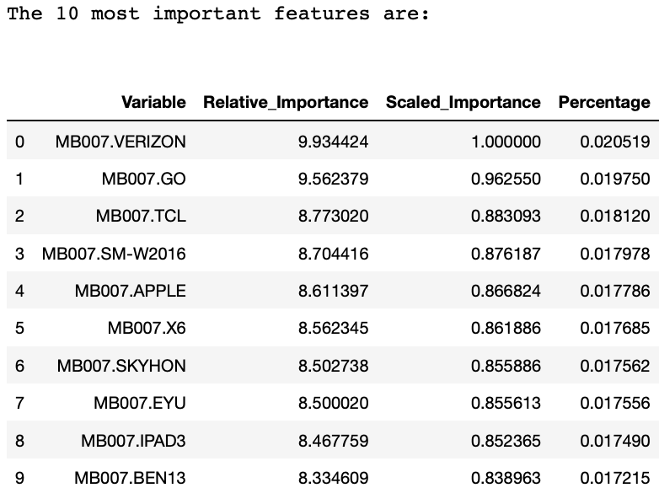
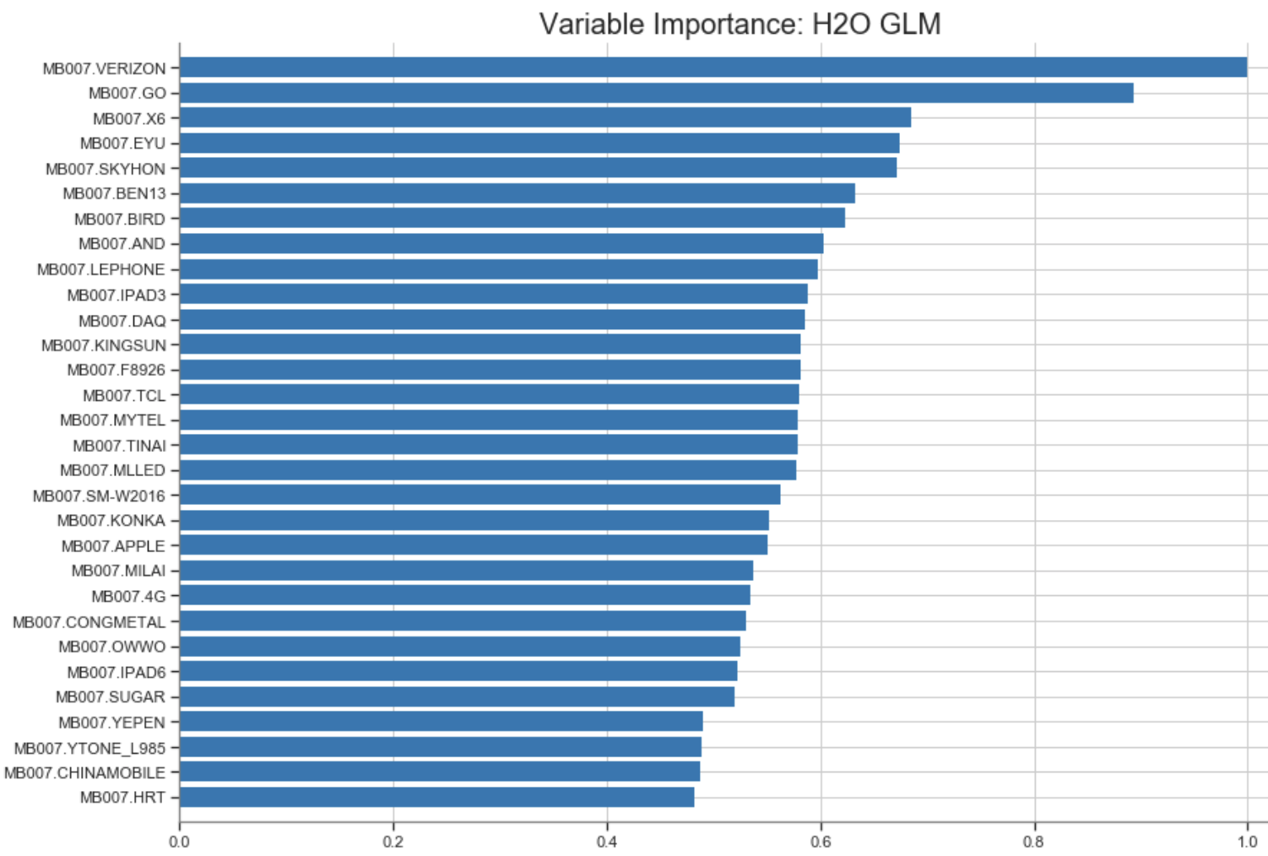
5420 Anomaly Detection, Fall 2020
- Harsh Dhanuka, hd2457
GLM Model
5
Feature Importance
MB007 – Type of Device/OS used for Loan application

Slide 10
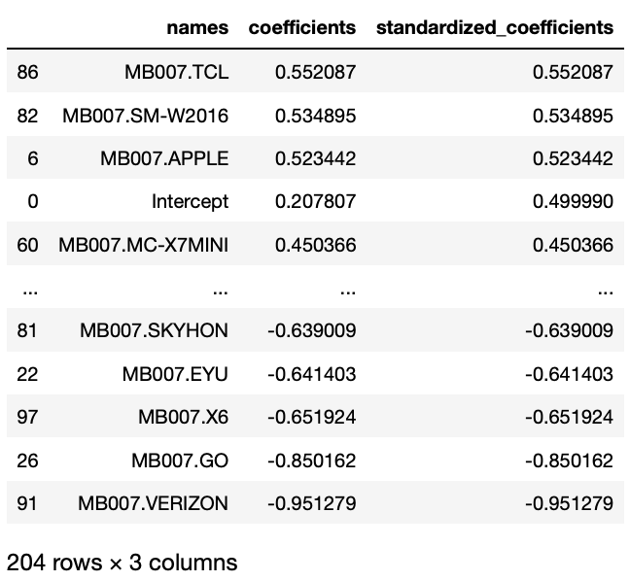
5420 Anomaly Detection, Fall 2020
- Harsh Dhanuka, hd2457
GLM Model
6
Coefficients Table
This gives us the coefficients and also the standardized coefficients for all the 204 variables, which was used to build the GLM model.
It is important to note that, I had 75 total variables, but H2O dummy codes the categorical variables automatically, hence 204 total variables.
Some of the values of the variable MB007 (device/OS type) are even more important than the intercept itself.

Slide 11
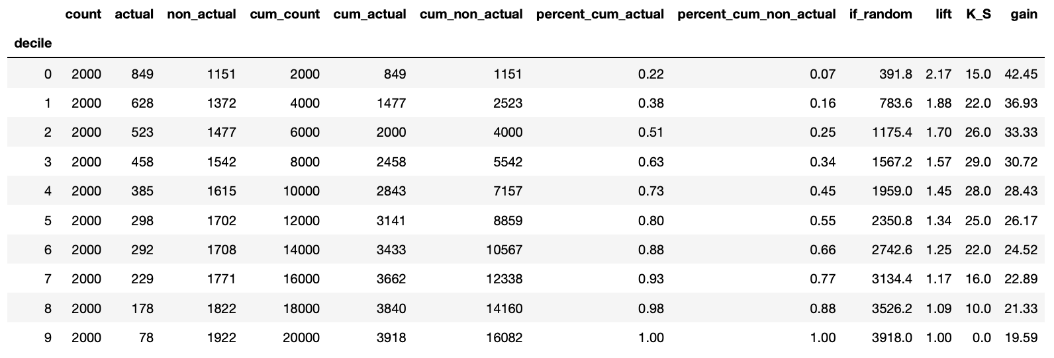
5420 Anomaly Detection, Fall 2020
- Harsh Dhanuka, hd2457
GLM Model
7
Gains Table and Lift
Lift is a measure of the effectiveness of a predictive model calculated as the ratio between the results obtained with and without the predictive model.

Slide 12
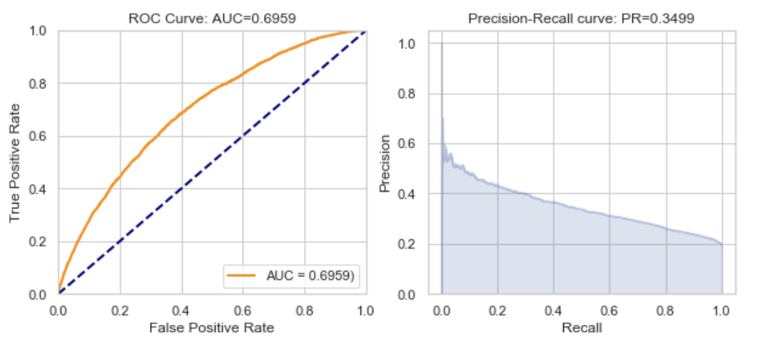
5420 Anomaly Detection, Fall 2020
- Harsh Dhanuka, hd2457
GLM Model
8
AUC and Precision Recall
ROC: The ROC curve plots the true positive rate vs. the false positive rate
AUC: A value between 0.5 (random) and 1.0 (perfect), measuring the prediction accuracy
Recall (R) = The number of true positives / (the number of true positives + the number of false negatives)

Slide 13
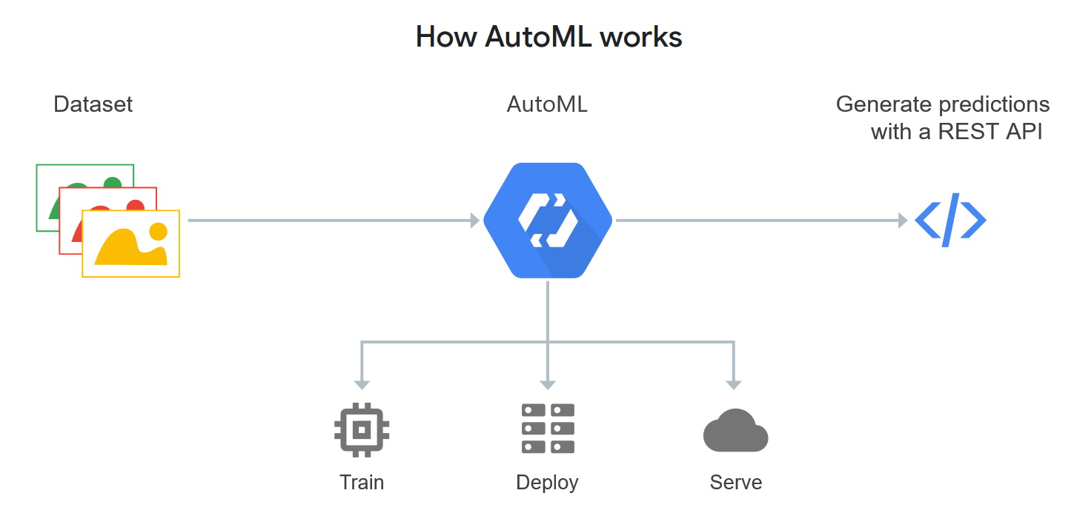
Auto ML Model
Automated machine learning (AutoML) is the process of automating the process of applying machine learning to real-world problems. AutoML covers the complete pipeline from the raw dataset to the deployable machine learning model.
Grid Search in Auto ML?
H2O’s AutoML can be used for automating the machine learning workflow, which includes automatic training and tuning of many models. AutoML performs a hyperparameter search over a variety of H2O algorithms in order to deliver the best model. Two manual parameters can be provided, which are max_run_time_secs and max_models.
The current version of AutoML trains and cross-validates the following algorithms (in the following order): three pre-specified XGBoost GBM (Gradient Boosting Machine) models, a fixed grid of GLMs, a default Random Forest (DRF), five pre-specified H2O GBMs, a near-default Deep Neural Net, an Extremely Randomized Forest (XRT), a random grid of XGBoost GBMs, a random grid of H2O GBMs, and a random grid of Deep Neural Nets.
https://docs.h2o.ai/h2o/latest-stable/h2o-docs/automl.html

Slide 14
5420 Anomaly Detection, Fall 2020
- Harsh Dhanuka, hd2457
Auto ML Model
2
AutoML Models Leaderboard to judge performance of the many different models
1
Run the AutoML model
I ran the AutoML model, only specifying the following parameters, without performing any Grid Search.
Final Parameters:
max_runtime_secs = 1800 # 30 minutes
max_models = 200 # test over 200 models
nfolds = 5
stopping_rounds = 0,
stopping_tolerance = 0.005,
balance_classes = False
The performance of the many different models built by the AutoML function can be evaluated through a leaderboard.
A default performance metric for each machine learning task, mean residual deviance for regression problems, is specified internally and the leaderboard will be sorted by that metric.
See next slide for leaderboard

Slide 15
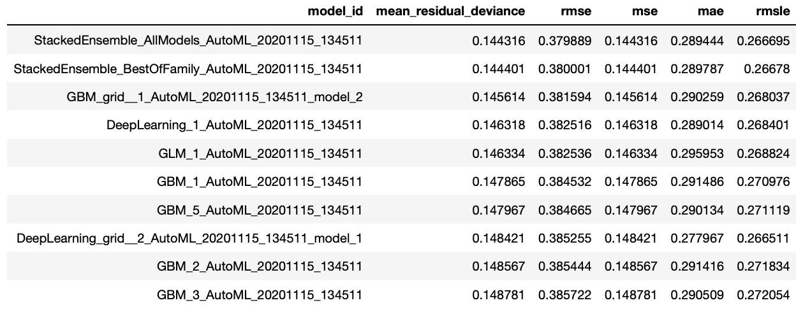
5420 Anomaly Detection, Fall 2020
- Harsh Dhanuka, hd2457
Auto ML Model
2
AutoML Models Leaderboard
See the performance of all models, sorted by mean_residual_deviance

Slide 16
5420 Anomaly Detection, Fall 2020
- Harsh Dhanuka, hd2457
Auto ML Model
3
Feature Importance
Var Imp function is not supported on the Stacked Ensemble models.

Slide 17
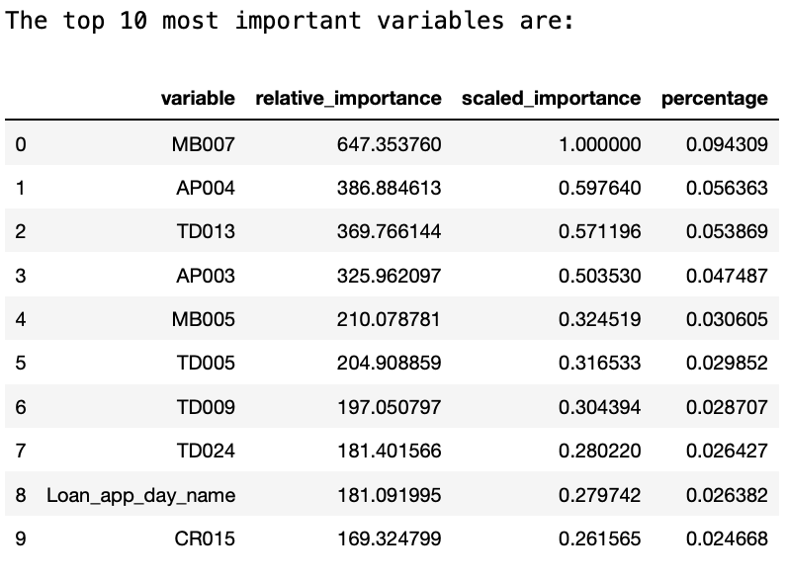
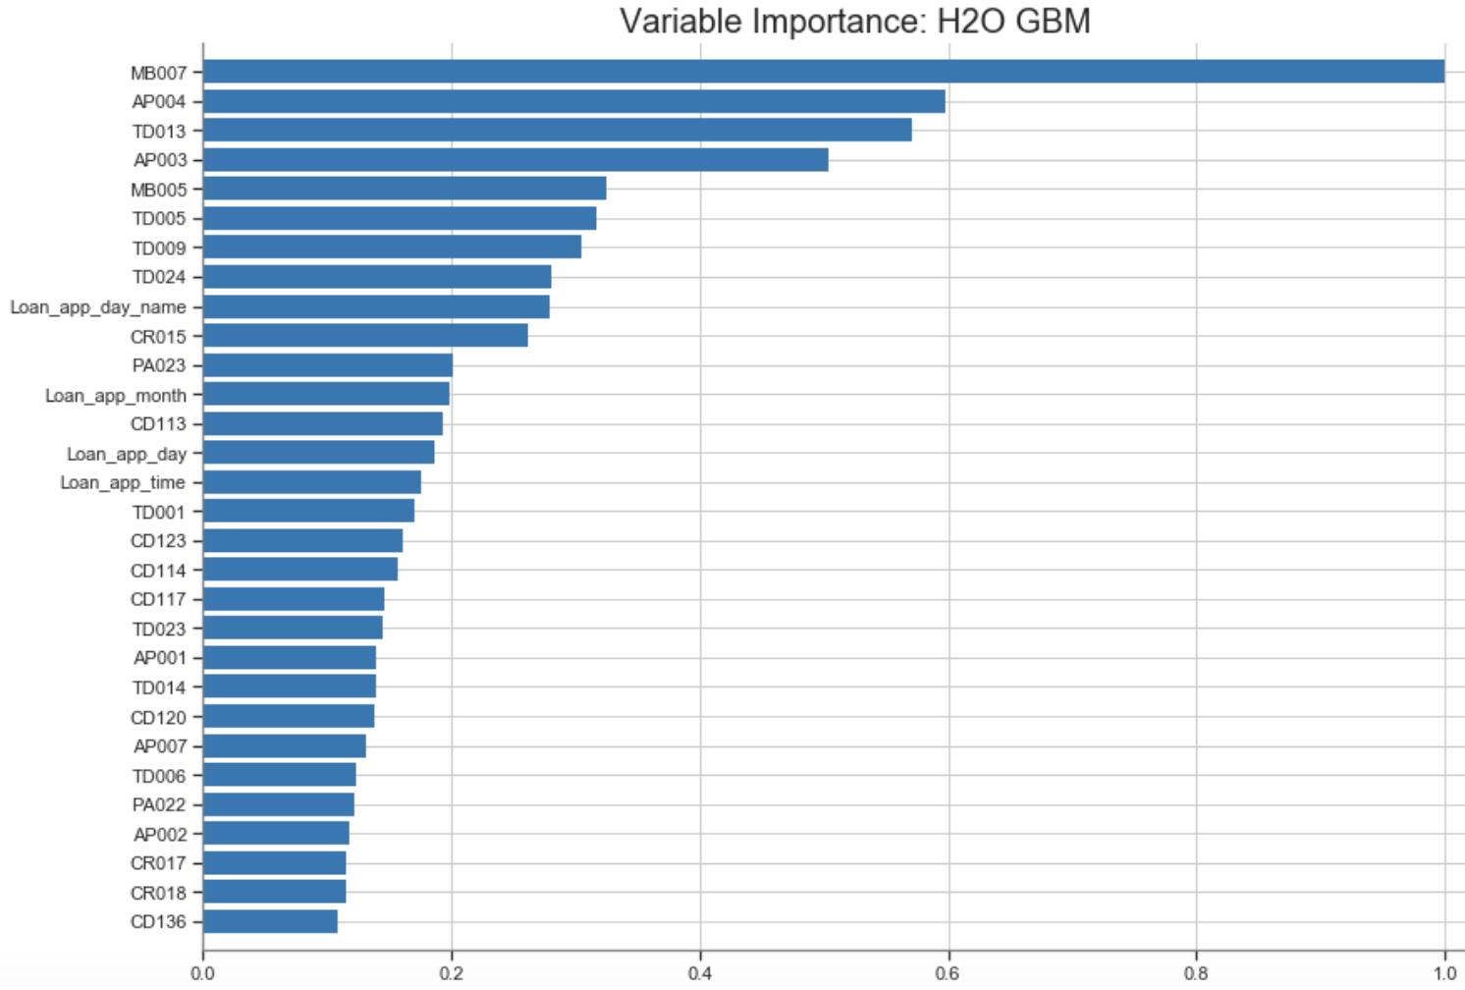
5420 Anomaly Detection, Fall 2020
- Harsh Dhanuka, hd2457
Auto ML Model
3
Feature Importance
MB007 – Type of Device/OS used for Loan application
AP004 – Loan Term

Slide 18
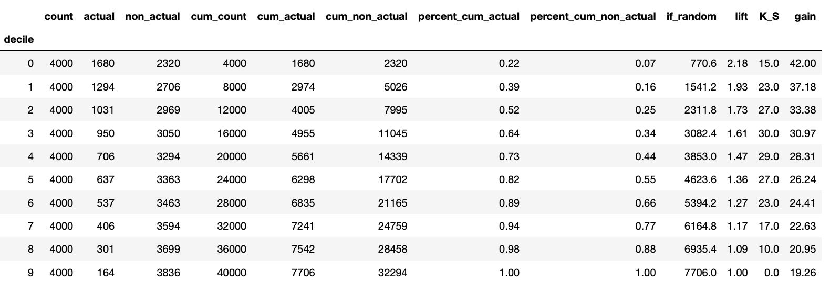
5420 Anomaly Detection, Fall 2020
- Harsh Dhanuka, hd2457
Auto ML Model
4
Gains Table and Lift
Lift is a measure of the effectiveness of a predictive model calculated as the ratio between the results obtained with and without the predictive model.

Slide 19
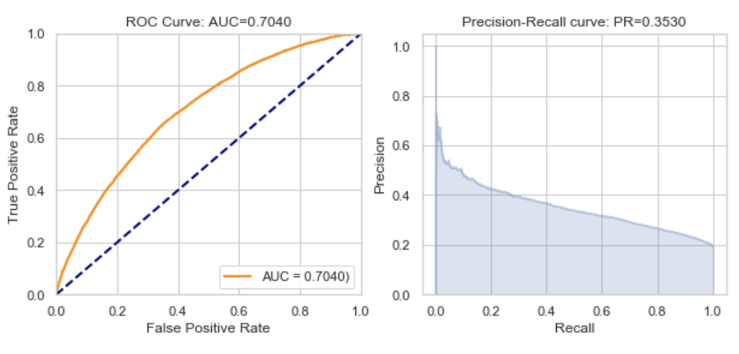
5420 Anomaly Detection, Fall 2020
- Harsh Dhanuka, hd2457
Auto ML Model
5
AUC and Precision Recall
ROC: The ROC curve plots the true positive rate vs. the false positive rate
AUC: A value between 0.5 (random) and 1.0 (perfect), measuring the prediction accuracy
Recall (R) = The number of true positives / (the number of true positives + the number of false negatives)

Slide 20
5420 Anomaly Detection, Fall 2020
- Harsh Dhanuka, hd2457
Business Insight
H2O packages: GLM, and Auto-ML are both very effective and efficient tools to build a machine learning model for predicting loan defaults. Also, H2O package is very handy to display the variable importance, handle correlations, and also dummy code the categorical variables.
Lift: For the final model I built after tuning all the different models on various different values of each parameter, the highest Lift score I obtained is 2.18, which is for the Auto-ML model, which is acceptable as per industry standards. A Lift score of above 2 is suitable for the model to be of acceptable standards.
AUC is 0.7 and PR score is 0.35 which is of acceptable standards. So the model is stable and fine.
As per the last few weeks, the most important variables I discovered are:
MB007 – Type of Device/OS
AP004 – Loan Term
Conclusion:
For this weeks models, Auto-ML is the preferred choice, as it is the father of many ML models.
Auto-ML through the H2O package is a good approach to predict loan default.
However, we should not undermine other individual and good models such as xgboost, RF, or the GBM, etc. These might provide better results as well, if the hyper parameters are tuned accordingly.

Slide 21
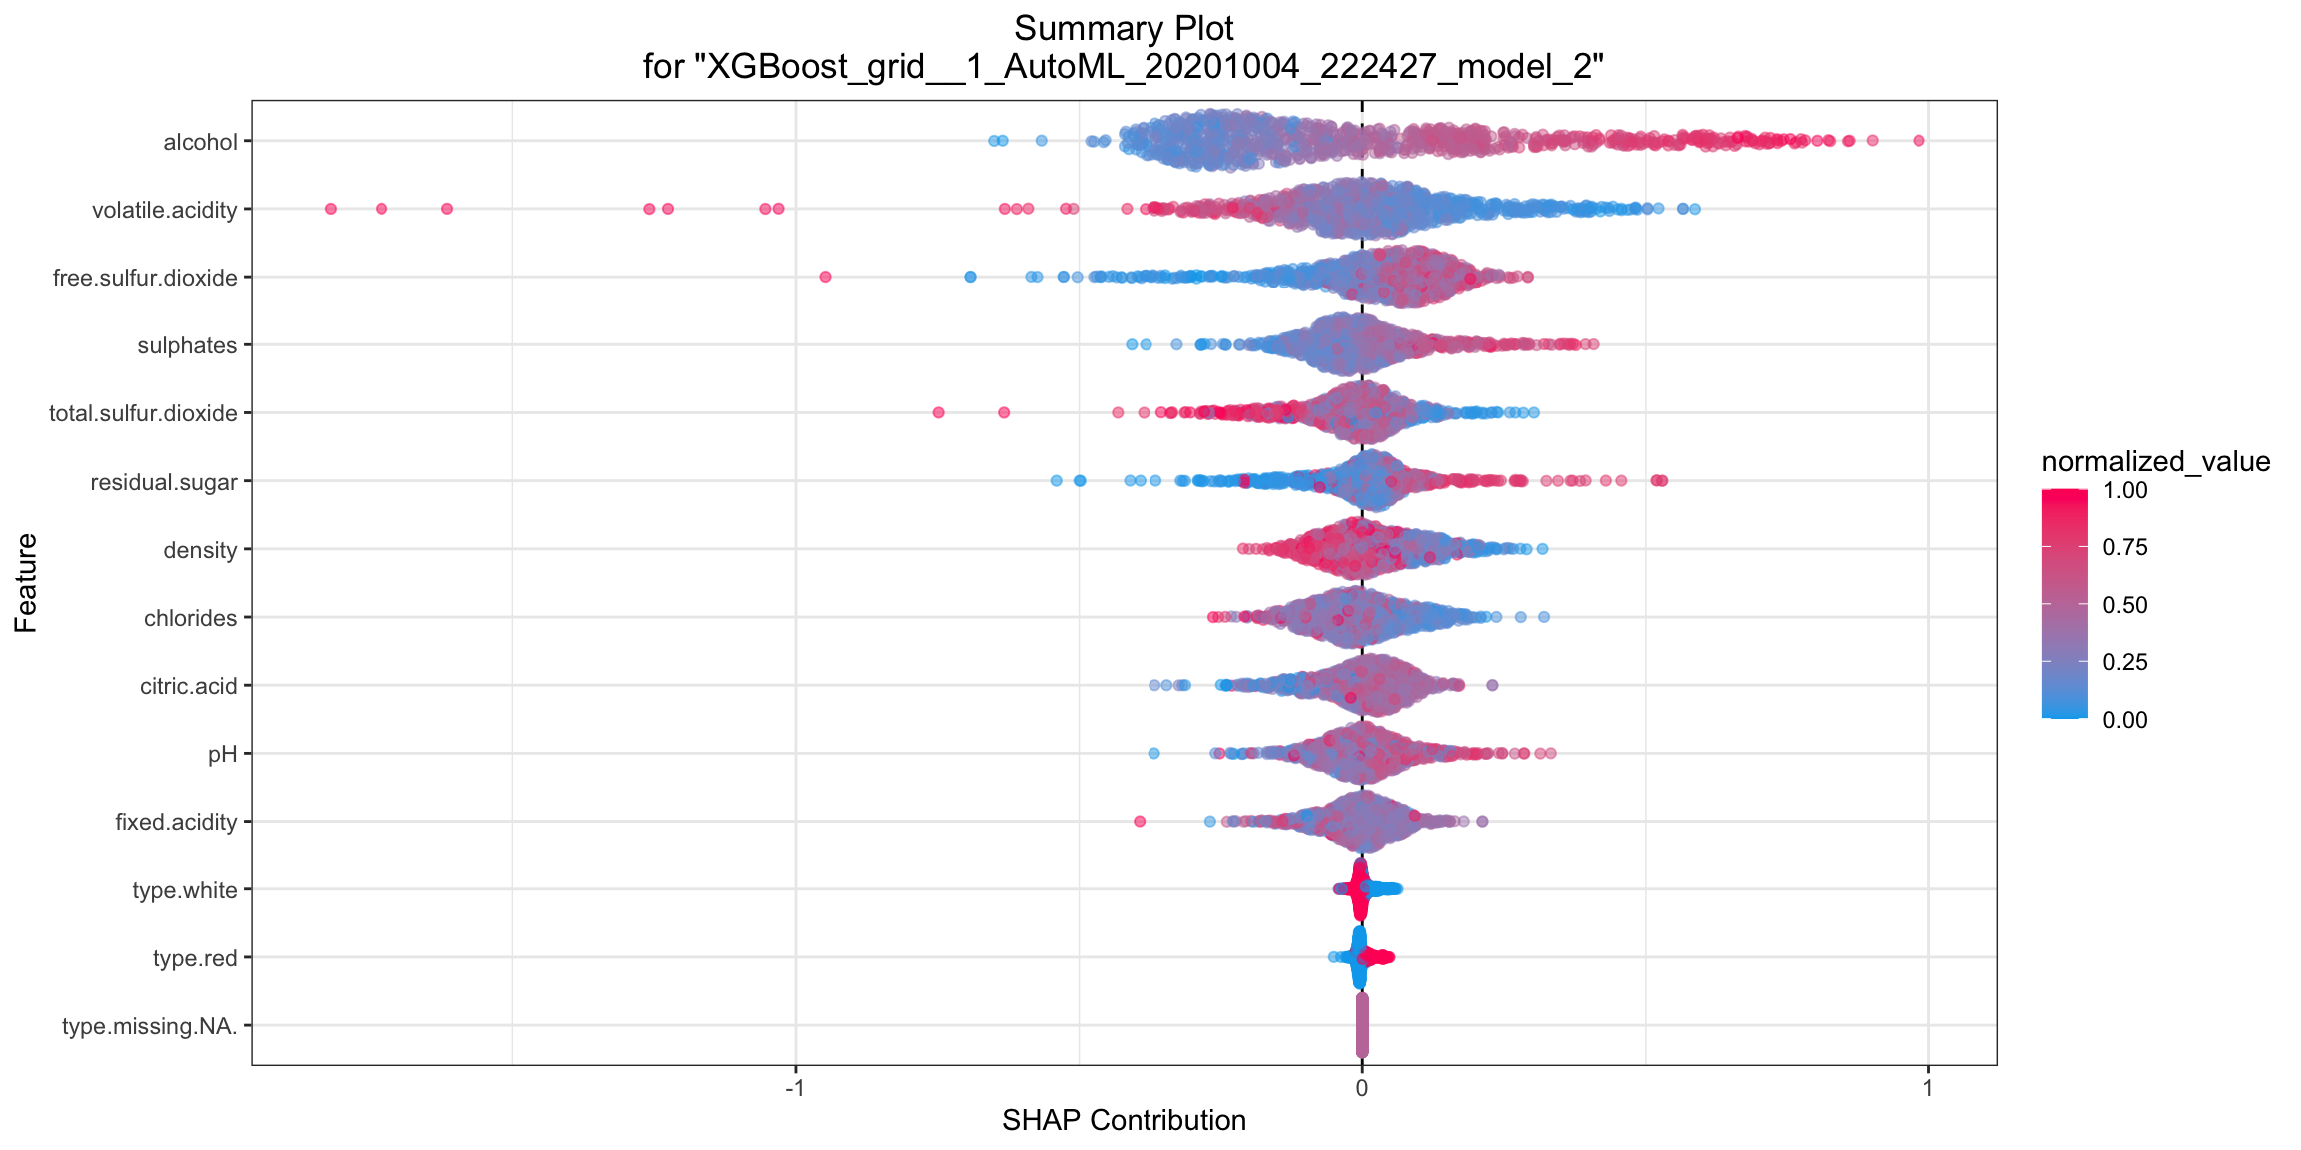
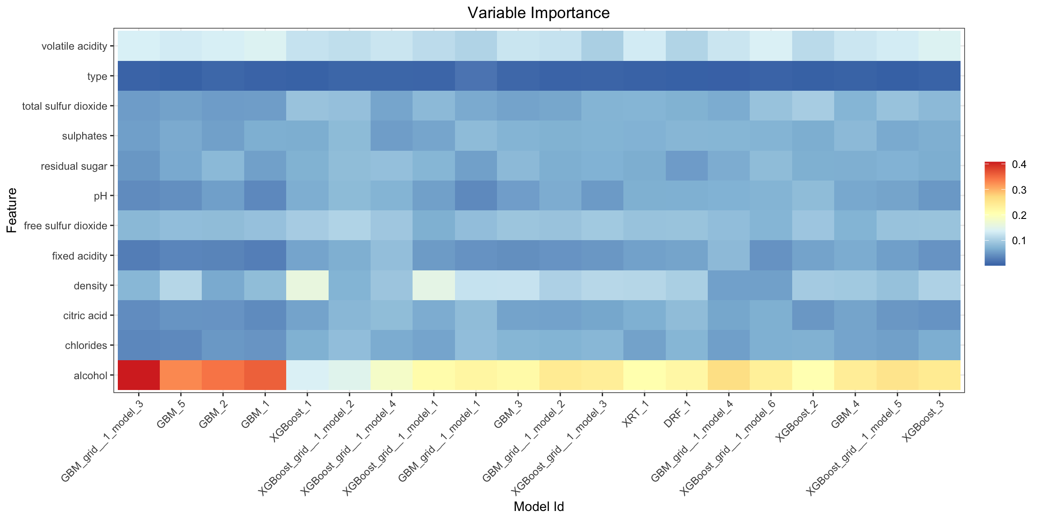
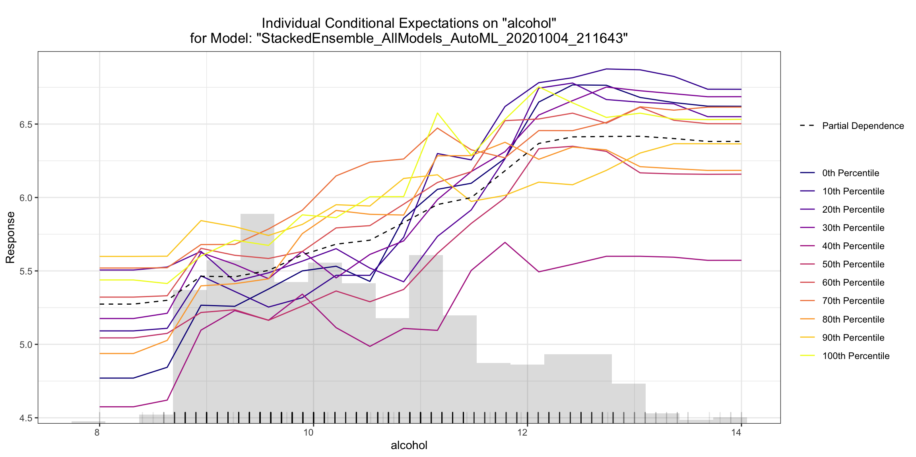
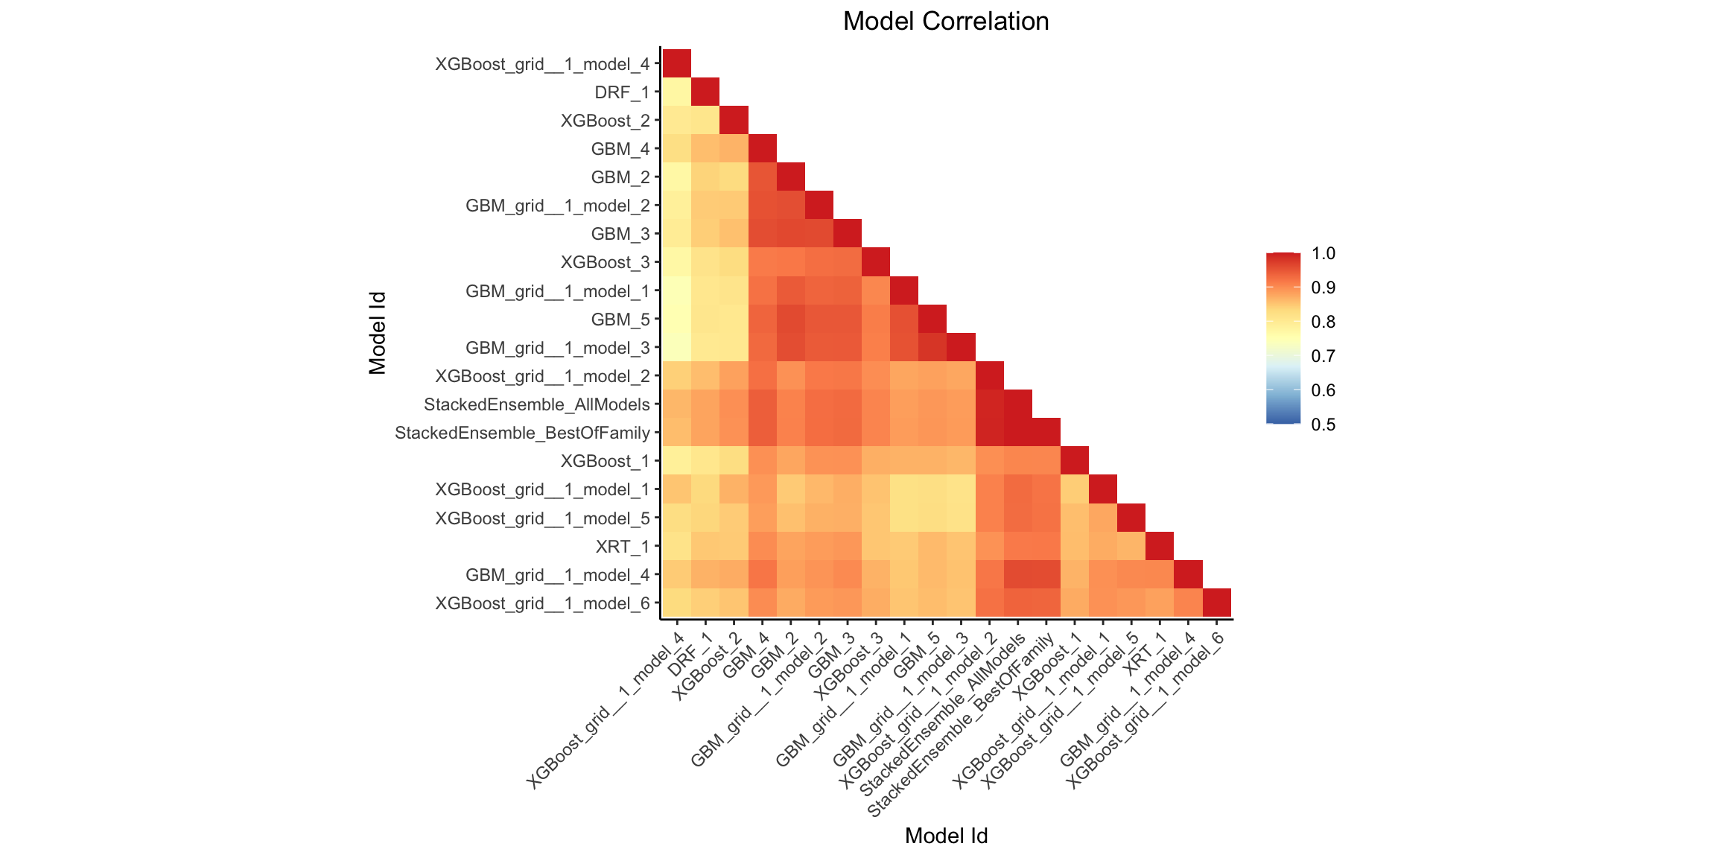
Auto ML Model
5420 Anomaly Detection, Fall 2020
- Harsh Dhanuka, hd2457
FUTURE CONSIDERATIONS for
Feature Importance

